Slide 1
Angela Lisa
Secondary Math Education
Bachelors Degree
Available Date of Hire: May 2016

Slide 2
Teaching Style
I would prefer to teach juniors or seniors in high school. The two subjects I wish to teach are algebra II and pre-calculus.
My learning style is more hands on and engaging. It is hard for me to learn during lecturers. Furthermore, I learn better when the teacher models the problems and then lets the students try on their own. I also like when teachers provide mini breaks in the lesson when the lesson is tough or long. Many other students also learn better this way. “When young people are expected to sit still for longer than 50-60 minutes at a time, they become restless” (Pangrazi & Beighle, 2009). This quote shows that’s students like me need to receive short breaks to keep their minds focused and engaged.
I would consider my teaching style to be a teacher-centered approach as a personal model. I teach best by modeling what the students will do before giving them a chance to work on their own. I also try to teach in a way that promotes self-sufficiency in each of my students. I “provide the support and encouragement necessary to acquire a personal sense of competence” in each of my students (Anspaugh & Ezell, 2013). This can be done by praising a student when they have done something correctly and encouraging students to try their hardest.

Slide 3
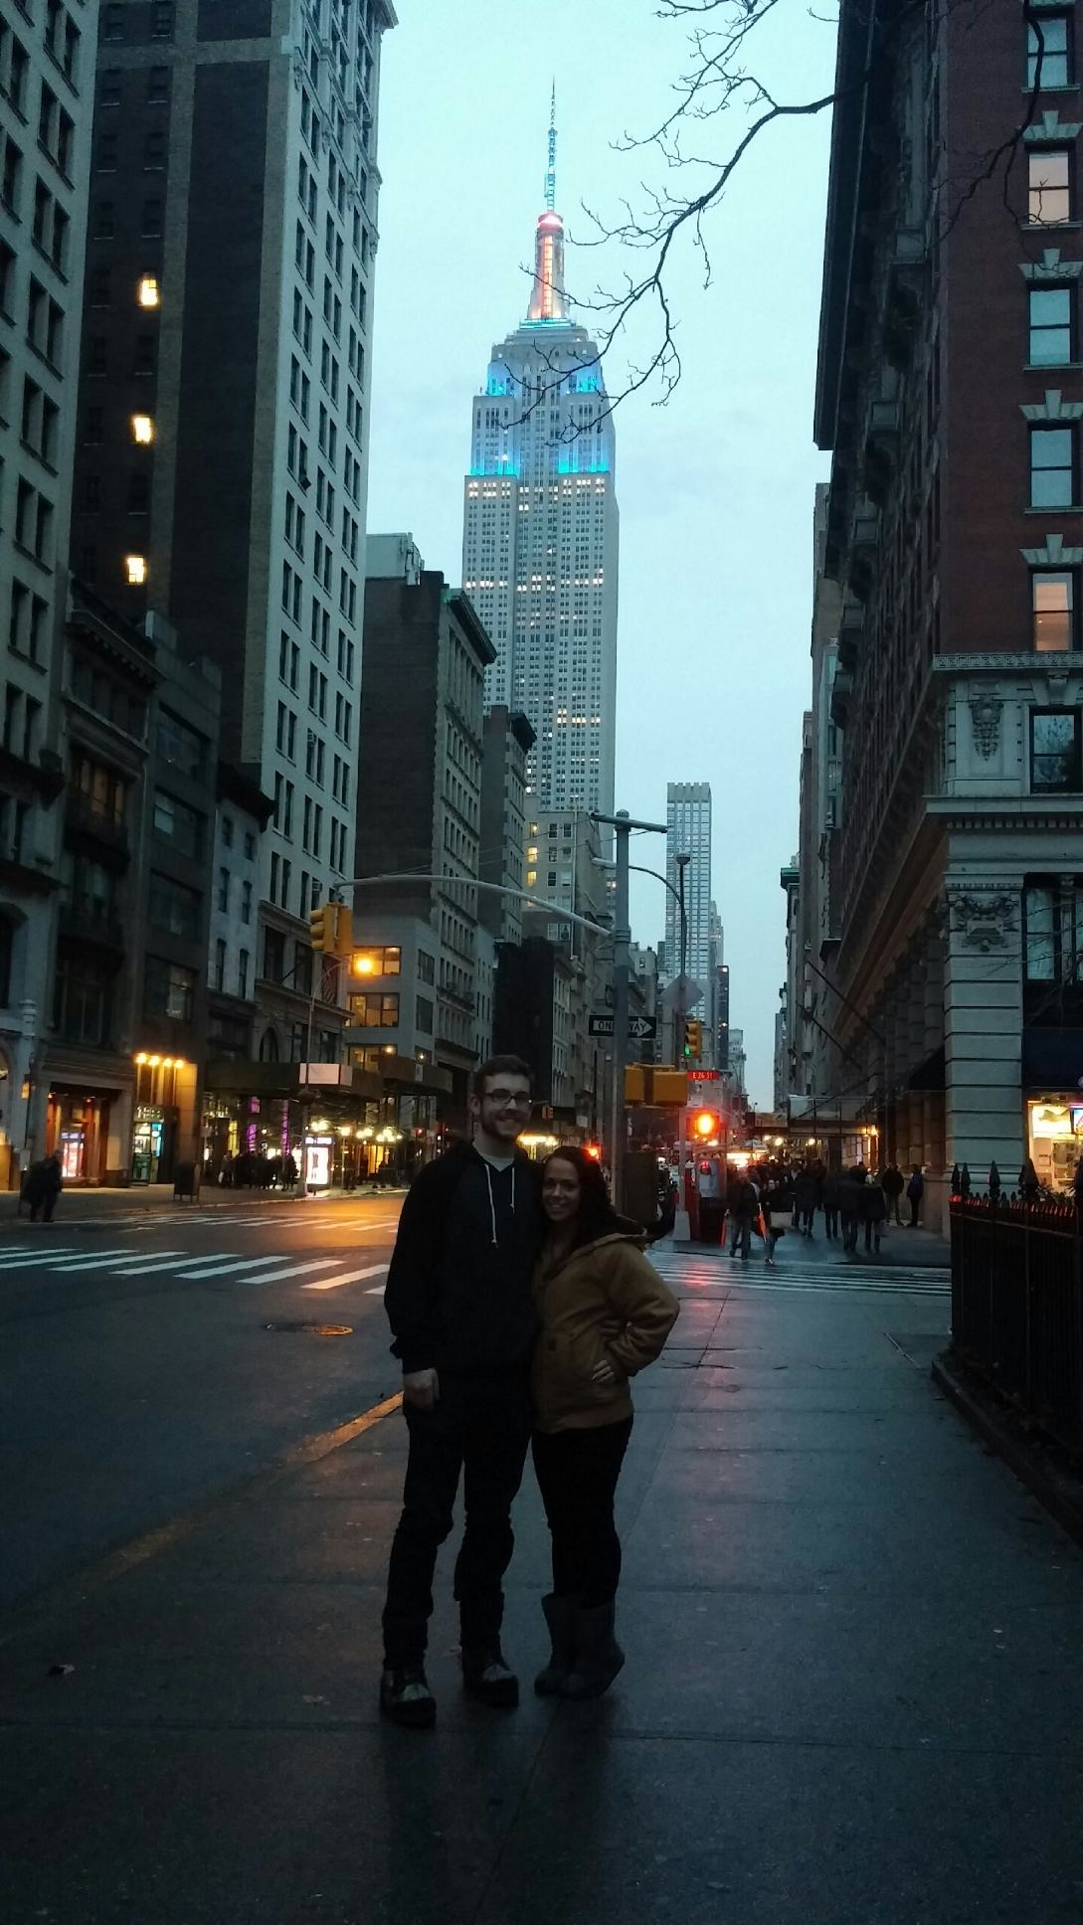
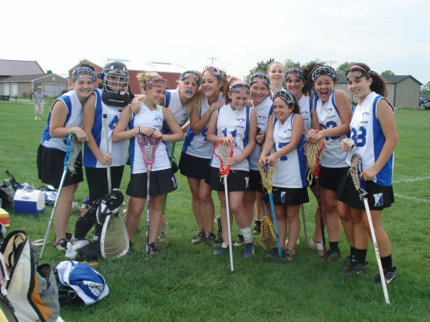
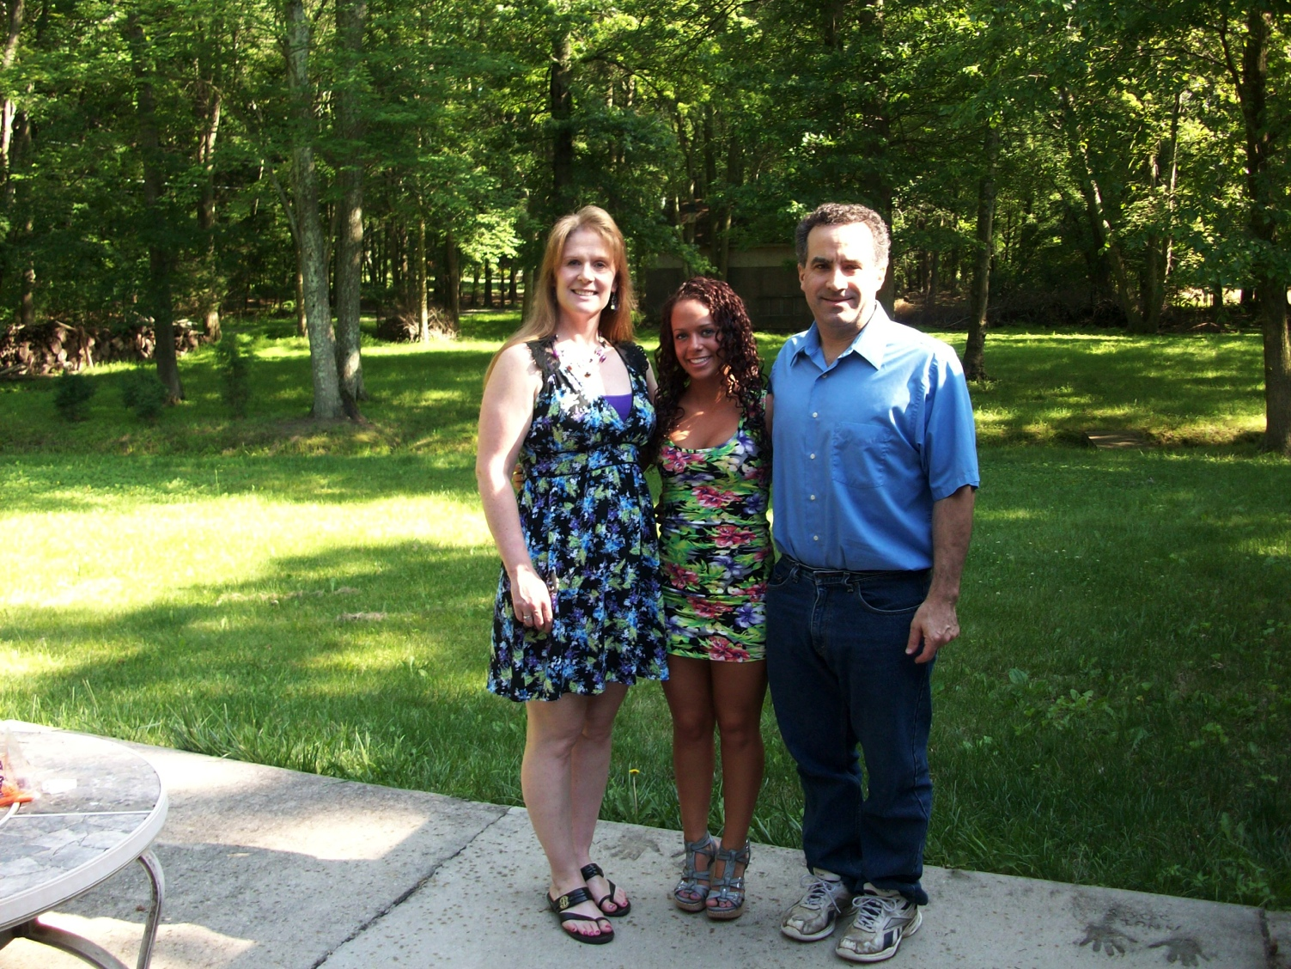
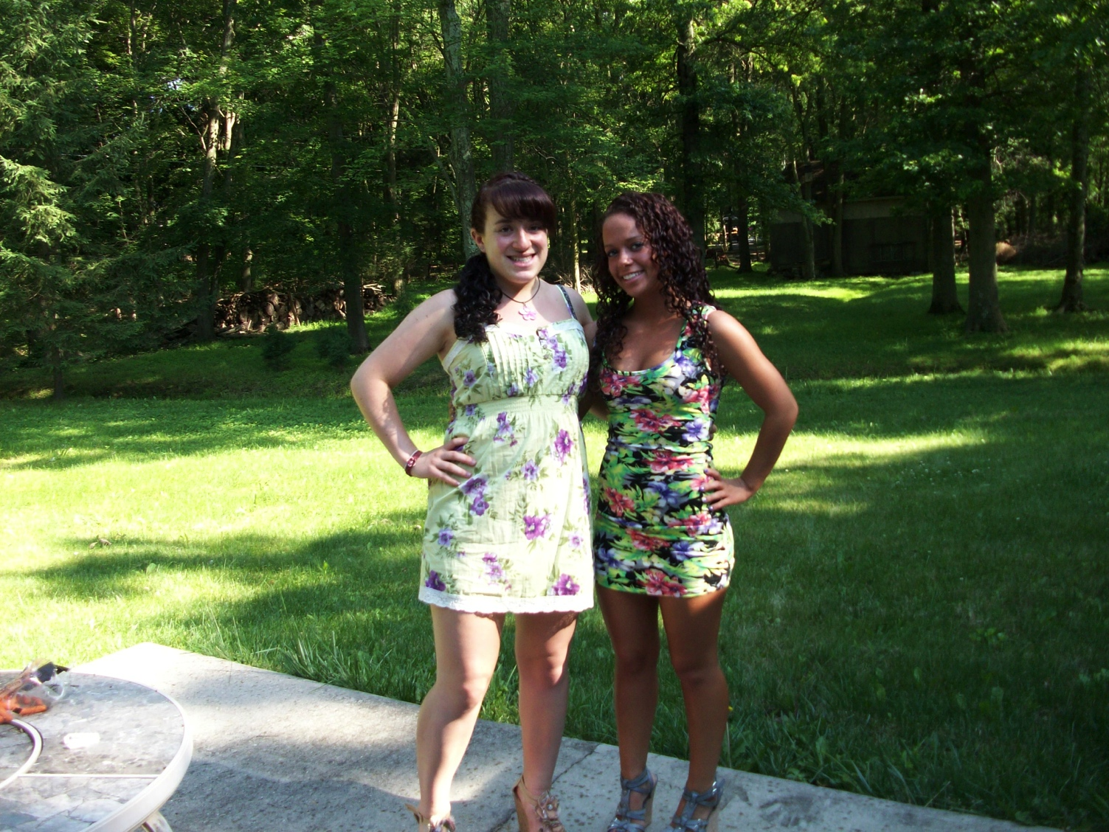
Pictures about me
Lacrosse in high school
My parents
My boyfriend and I in new york
My sister and I

Slide 4
Clubs and Activities
I would be interested in being part of or leading a community service club. I think it is important for students to get involved with helping others.
I would also be willing to be involved with the mathletes team at the school.
I could also host tutoring before and after school a few days a week.

Slide 5
Words that describe Me
National Honors Society (high school)
Spanish Honors Society (high school)
Dean’s List (college)
Hard working
Punctual
Organized
Helpful
Kind
Understanding

Slide 6
Why I Chose Education
I have always wanted to be a teacher for as long as I can remember. At first I was leaning more towards elementary education. However, I started working at a school and I quickly realized that elementary students were not right for me. During this time, I had an amazing algebra II teacher. She made me realize that I wanted to become a high school math teacher. I wanted to inspire and help students learn just as she had done for me.

Slide 7
Contact Information
Cell Phone: (609)-784-3006
E-Mail: amlisa@asu.edu
You can locate my resume and cover letter on page 8 of this powerpoint
“Teaching is the profession that teaches all other professions”
I find this quote inspiring because it points out that teaching is the basis for all other careers. In essence, someone can’t perform their job unless the skills and knowledge required for that job was taught to them. Therefor, this quote emphasizes how important teachers are.

Slide 8
Resume and Cover letter

